Slide 1
Air Force Reserve Command Civil Engineer Program Overview
Mr Bob Staib
HQ AFRC/A4C
19 Jul 2017
1
Notes:
1
A7P is overall POC for this briefing (same brief used for Annual Robins AFB Requirements Symposium in Nov and SAME Robins AFB Post brief in Jun)
Slide POC: A7PP
Updated: 26 May 13 (changed date)
Civil Engineer
Facilities (construction, maintenance & environmental)
Fire Emergency Services
Emergency management
Explosive Ordnance Disposal
Contracting
Security Forces
AT/FP
Physical Security & Police Services
Combat Arms

Slide 2
Overview
Engineer Responsibilities
Facilities Programs
Installation Ops & Environmental
Civil Engineer Readiness
Where Do I Get More Info?
Notes:
The Defense Strategic Guidance states that, “Our Nation is at a moment of transition,” “a strategic turning point.” The United States must put its fiscal house in order, while the DoD & the Services reshape for the future.
Meeting the myriad strategic & fiscal opportunities & challenges requires leadership.
In A7 we are posturing for the future, whether it involves operating in anti-access environments or capitalizing on evolving resourcing dynamics.
During your visit with our great staff this morning, you will hear them describe some of these efforts.

Slide 3
Engineer Responsibilities
Facility Programs
Installation
Ops & Env
Civil Engineer Readiness
Program Development
FOCUS & Community Planning
MILCON & FSRM prgm dev
Mission Beddown Facility Spt
Program Management
MILCON & FSRM project execution
Support to base/tenants
Comprehensive Interior Design
Installation Operations
BOS Contract lead
Infrastructure oversight
Energy Management
Environment & Asset Accountability
Environmental Quality
Asset Accountability
Real Property/Real Estate
Emergency Services
Fire Emergency Services (FES)
Explosive Ordnance Disposal (EOD)
Emergency Management (EM)
Readiness and Sustainment
Prime BEEF
RED HORSE
Command-wide initiatives
$7.47B Physical Plant & 5,000 Deployable Engineers
Notes:
SCRIPT: Our team of 62 engineers and program managers cover the full spectrum of engineer responsibilities. We generally group these responsibilities into 3 broad areas depicted on the slide:
Facility Programs area covers our larger facility repair and construction efforts via MILCON and FSRM (Facilities Sustainment Repair and Modernization) programs.
Installation Operations and Environmental Programs provide for the day to day operation and stewardship of our real property assets.
Finally, we manage the command’s Civil Engineer Readiness forces of Emergency Services including Fire Fighters, EOD and Emergency Management/CBRN capabilities as well as our Prime BEEF and RED HORSE capabilities.
Bottomline, we have the collective responsibility to manage the commands $7.5B Physical Plant while preparing over 5,000 engineers for potential deployment in support of our Combatant Commanders.
I’ll cover the areas highlighted in bold print in more detail.
NOTES:
Merger: 3 Divisions w/8 Branches merged into One Division w/ 6 Branches; ~ 68 to 62 auth
Plant Replacement Value = ReCap PRV as of “end of FY15”
Our PRV as shown here includes both Host and Tenant locations
* Total AFRC Recap PRV = $7.5 B
* Host PRV & % = $4.65 B; 62%
* Tenant PRV & % = $2.85 B; 38%
Deployable Engineers: ~5,000 (~4,500 TRs, ~100 ARTs,~ 100 AGRs, ~300 IMAs)

Slide 4
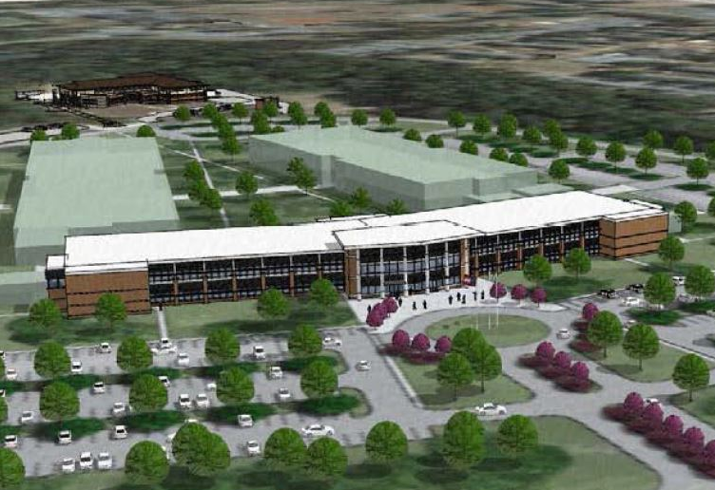
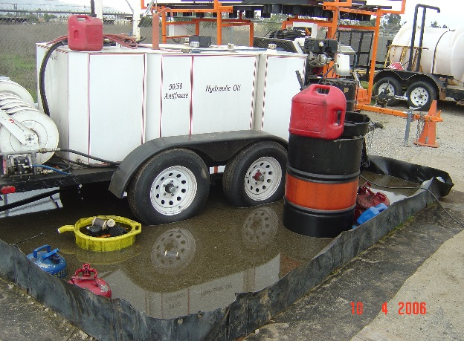
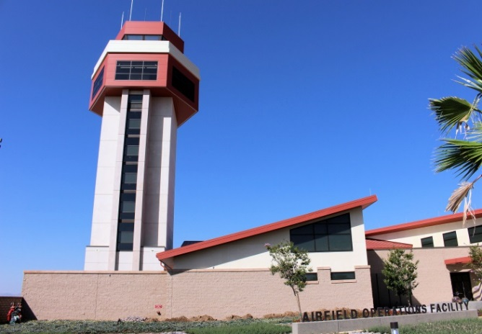
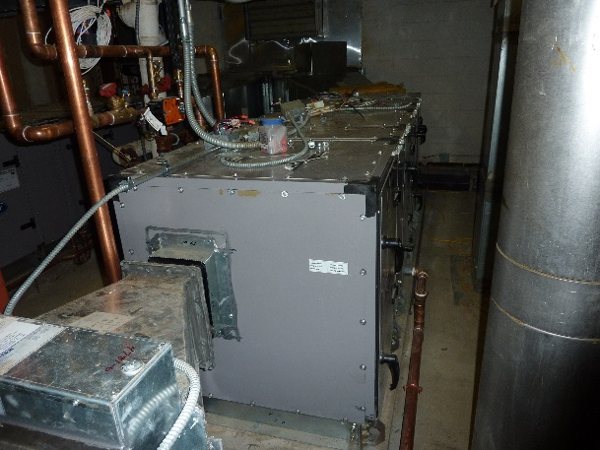
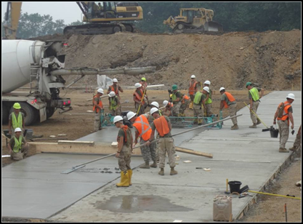
A4C: Civil Engineer Division
A4CA Picture
A4CD: Program Development
Mr Bob Akridge
A4CA: Environmental &
Asset Accountability
Mr Earl Aler
A4CE: Emergency Services
Mr Tom Morris
A4CO Picture
A4CM: Program Management
Mr Scott Wall, Sr
A4CO: Installation Operations
Mr Ray Knapek
A4CX: Readiness & Sustainment
CMSgt Ron Aickelin
Notes:
SCRIPT:
Good morning (afternoon)
NOTES: Pictures, Clockwise
Upper Left: Rendering of Phase I Consolidated Mission Complex, HQ AFRC, Robins AFB
Upper Right: Control Tower and Base Ops Facility, March ARB, FY12 MILCON project which won AF-level Design Award. $18.4M, operational summer 2014.
Lower Right: Expeditionary Civil Engineers lay concrete ramp
Lower Left: Fire Fighters conduct live fire training at an Aircraft Crash Rescue Training Facility

Slide 5
AFRC Footprint Host & Tenant Installations
Alaska
●
ARPC
Guam
4AF
22AF
HQ AFRC
Hawaii
10AF
9 Host installations – 57 Tenant Locations/Ranges
33 Flying Wings, 12 Flying Groups, 1 Space Wing Over 70K Citizen Airmen
$7.47B Plant Replacement Value, 21K Acres, ~3K Facilities
Notes:
Slide POC: A7PP, updated 31 May 2013
AFRC plant replacement value of $6.13B or 3.2% of AF PRV; nearly 1,200 buildings
Nine host installations PRV:$4.10B
Buildings: 13 Million Square Feet (Source: April 2013 Reserve Snapshot)
- About 2 Pentagons – 6,500,000 SF (Source: http://www.infoplease.com/spot/pentagon1.html)
Over 4 1/2 times Empire State Building’s 2,768,591 square feet (Source: http://www.mastersoftrivia.com/blog/2011/05/11-fascinating-facts-about-the-empire-state-building/)
Land: 21,000 Acres (Source: Mr David D’Amore, A7IA)
Equivalent to almost 42 Disneylands (source: http://corporate.disney.go.com/)
Over 19 Perry Agricenters in acreage (source: http://www.gnfa.com/)
Airfield Pavement: 15M Square Yards (Source: April 2013 Reserve Snapshot)
-Equivalent to 4.8 square miles of concrete
Locations: 66 where AFRC has real estate interest
• 5 Air Reserve Bases (Dobbins ARB, Grissom ARB, Homestead ARB, March ARB, Westover ARB)
• 4 Air Reserve Stations (Minn-St Paul IAP ARS, Niagara Falls IAP ARS, Pittsburgh IAP ARS and Youngstown-Warren ARS)
• 3 Navy Tenant Locations (Carswell, JB Pearl Harbor-Hickam, & JB Guam-Andersen)
• 4 Army Tenant Locations (Pope, Ft Sill/Falcon Range, Ft Wolters & JB Lewis McChord)
• 1 ANG Tenant Location (Portland)
• 42 AF Tenant Locations
• 3 Miscellaneous Locations (Minn St. Paul O’Club Annex MN, Rosecrans Memorial Airport MO, and Starvaggi Training Site PA)
• 4 Ranges (Claiborne LA, Clinton PA, Snelling MN, and Consol OH)
Slide POC: A7PP
Updated: 31 May 13 – updated based on data in AFRC Snapshot – Jun 2013
From an operational perspective, the Air Force Reserve Command is one of ten MAJCOMs, and is the largest personnel-wise with nearly 75K people (source: AFR Snapshot, June 2013):
Traditional 48,618; ART—10,400; IMA—8,974; AGR—2,888; Civilian—4,024

Slide 6
Facility Programs Installation Planning
Base | IDP Status (ECD) | AICUZ Status
Dobbins | Jun 15 | 2011 - Complete
Grissom | Sep 15 | 2014 - Complete
Homestead | Oct 15 | 2017 - Complete
March | Dec 15 | update underway
Minneapolis | Jul 15 | N/A
Niagara | Aug 15 | 2015 - Complete
Pittsburgh | Jul 15 | N/A
Westover | Jun 15 | 2012 - Complete
Youngstown | Aug 15 | N/A
IDP documents 20-30 year installation development vision
ADP provides details for specific mission areas
(tenants)
Products maintained on AFRC SharePoint site to facilitate Installation Facility Boards requirements
On-Site expertise provided to AFRC Installations and Tenants as available
Take-away
Objective: All AFRC Bases and Stations compliant by the end of Dec 15
Measure: Installation Development Plans(IDP) completed in accordance with AFI 32-7062
Data Source: Program Management Plan and base-reported data
Make sure IDP reflects your priorities
Stick to the plan as much as possible!
Installation planning is cornerstone to long-term program success
3 Mar 14
AFRC/A7PP

Slide 7
Facility Programs Facilities Operational Capability and Utilization Survey (FOCUS)
FY07 initiative to evaluate facility use & facility condition at all AFRC operation locations
Implement consistent standards
Quantify true facility funding needs
5 Year Cycle
1st Round, FY08-11 effort surveyed 47 locations
2nd Round, FY12-15 plan to survey 33 locations
Added BUILDER / S-File data
Challenges
Right-size units & comply with AFRCH 32-1001
Develop executable plans (O&M vs. MILCON)
Consider changing force structure
Identify ALL facility requirements
Utilities, Pavements, Energy, etc.
Standardized, enterprise-wide facility assessment
Notes:
Facilities Operations and Capabilities Utilization Survey (FOCUS)
The Focus program began in FY07 as an A7 initiative to put the same set of eyes on all the AFRC facilities at all of the AFRC operating locations.
The intent was to ensure that we were maintaining our facilities to the same standard and to ensure that proper space was available for all organizations. In doing so, we are able to capture our true facility funding needs.
We started the effort back in FY08 on a 4 year cycle in which we visited 46 locations. We are currently in the last year of our second 4 year cycle in which we are visiting 33 locations.
As we visit the different locations and reassess the units, some of the challenges that we are having to deal with include: trying to right-size the units and still comply with the AF 20/20 by 2020 goal and minimizing the use of MILCON funds. In addition, pending force structure changes at many locations make future facility planning difficult.
Total Assessed 1st Round - 13.0M NSF / 17.4 GSF
Total Assessed 2nd Round – 12.3M NSF / 16.9 GSF

Slide 8
Facility Programs AFRC MILCON Program Funding
FY17 spike is KC-46 beddown wedge
No current mission projects in FY17
Limited P341 used for force structure out-of-cycle change
Louisville COE District is lead for AFRC programs
$M
Countermeasure
All numbers are programmed amounts & include P&D & P341 funds
Continue mission critical, investment focus
Ensure every dollar counts
Objective: Recapitalize AFRC facilities for mission critical requirements
Measures: Program funding vs. $100M requirement to buy down $1B
backlog
Data Source: President’s Budgets
Reduced MILCON funding levels puts additional pressure on O&M FSRM Program
30 Nov 13
A7PP
Notes:
AFRC FOCUS program has validated $1B in AFRC MILCON requirements. The AF MILCON program is very limited. AFRC has established $100M as a reasonable level of execution per year to buy-down the MILCON backlog over an approximately 10 year period. FOCUS now concentrating on O&M solutions to fix condition/space deficiencies
Out-year fund line drives pressure for O&M solutions, hurts new mission chances
Average MILCON program over last 22 years = $41.49M ($26.413M without inserts)
Highest funding years were 2010 ($107.6M—largest in AFR history), 2005 ($100.9M), & 2006 ($95.687M)
Lowest funding years were 2011 ($3.413M), 1991 ($3.85M), & 2013 ($6.1M)
FY13 is third lowest MILCON program funding in the last 22 years. In FY13, strategic pause in AF MILCON due to Force Structure Announcement; AF program limited to Corporate initiatives & New Mission MILCON, using $900M+ for higher priority bills.
Congress added $83M to AFR request in FY10; no Congressional inserts or adds since
FY11-13 AFR MILCON funding was short $62.9M vice 3.8% MILCON equity (in past rounded up to 4%)—most severely underfunded 3 year stretch in last 22 years
FY11 received 0.6% of $1.2836B AF TOA vice 3.8% equity (3.2% short = $40.9M)
FY12 received 2.4% of $1.3769B AF TOA vice 3.8% equity (1.4% short = $18.7M)
FY13 received 2.9% of $375.9M AF TOA vice 3.8% equity (0.9% short = $3.3M)
========================
FY10 MILCON Auth/Approp 15 projs, $107.6M awarded (Largest in AFRC history)
FY11 MILCON Auth/Approp 1 Proj, $7.8M – 1 proj @ Patrick AFB Munitions Maintenance Facility)
FY12 MILCON Auth/Approp (March ATC Tower/Base Ops $16.4M; Charleston RED HORSE Training $9.6M)
FY13 PB MILCON Auth/Approp ($6.1M for Niagara C130 Simulator)
FY14 PB MILCON Auth/Approp
March Deployment Processing Center, $19.9M
Tinker Air Control Group, $12.2M
Homestead Entry Control Gate, $9.8M
FY15 PB MILCON Auth/Approp
Robins Consolidated Mission Complex Ph 1, $27.7M
Seymour Johnson Tanker Parking Apron Expansion, $9.8M
NAS Ft Worth EOD Facility, $3.7M

Slide 9
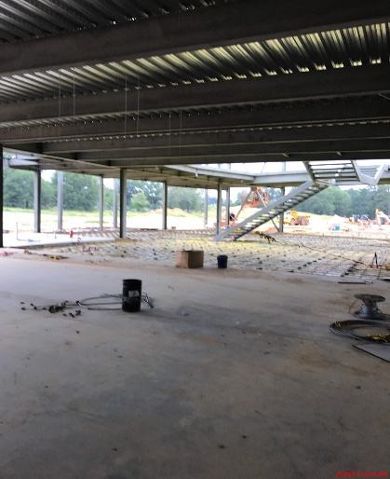
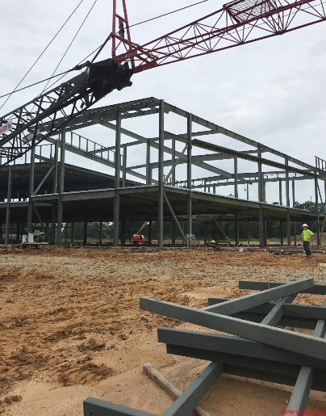
Facility Programs Future MILCON Projects
Near Term Projects
$150M+ FY18 Program (maybe?)
Host & Tenant locations
Projects Range $3M - $51M
FY18 Budget Process: HAC & SASC propose increases to AFR MILCON
Notes:
Our facility investment strategy focuses on right-sizing, sustaining & recapitalizing our installation power projection & training platforms
1 Robins GA HQ AFRC Phase 1
2 Seymour J. NC Tanker Parking Apron Expansion
3 Davis M. AZ Guardian Angel Operations
4 Dobbins GA Fire Station / Security Complex
5 Westover MA C-5 Aircraft Maintenance Shop Facility
6 Carswell TX Add Simulator Bay, Building 1792
7 Keesler MS Aeromedical Staging Squadron
8 Lackland TX Consolidate 433 Medical Facility
9 Homestead FL Add Simulator Training Facility, B191
10 Homestead FL Live Ordnance Load Area
11 Youngstown OH Firing Range
12 Dobbins GA Fitness Center Facility
13 Westover MA AF Regional ISO Maintenance Hangar
14 Whiteman MO Munitions Trailer Maintenance Facility
15 Grissom IN Aircraft Maintenance Hangar (Nose Dock 5)
16 Robins GA Consolidate HQ AFRC Phase 2
17 Hill UT Reserve Medical Training Facility
18 Anderson GU ASTF Facility Addition
19 Maxwell AL Aircraft Parking Ramp
20 Pittsburgh PA Wing Headquarters

Slide 10
Facility Programs AFRC FSRM Program Funding
Great Teamwork! CE, FM, CONS, CoE, JA
Bought out executable FY15 requirements
6 yr obs avg: $172M/yr
$200M FY16 FSRM IPL approved; executed $93.7M
Budget cuts will drive IPL importance and discipline
Execution goal between 2%-4%PRV
($150-$300M)
Buy down $1.5B O&M FOCUS-validated backlog
MILCON reductions mean higher need for O&M FSRM
4% PRV
$M
2% PRV
Objective: Recapitalize AFRC facilities to meet critical mission requirements
Measures: Program funding vs. 2%-4% PRV ($150-$300M/yr) to maintain facilities
Data Source: Execution, FY16 PB
Countermeasure
Continue “worst-first” AFRC Corp. Structure approved strategy
Investing 2-4% of PRV Keep Good Facilities Good
10 Aug 12
A7PD
Notes:
The chart shows project funding only (EEIC 521, 522, 524, 529)
It does not include Civ Pay, supplies or other O&M requirements (PECs 52576, 52578)
As shown here, AFRC did quite well in FY15 in the SRM arena
CE worked hard with FM, CONS, the Corps and JA to ensure we were ready to execute EOY fallout
This resulted in the execution of $159M in requirements
This EOY funding allowed us to buy-down approximately $102M of our FOCUS validated backlog of facility requirements.
And the AFRC Commander recently approved us building a $200M Integrated Priority List for FY16 to ensure we remain able to execute any fallout
Sustained investment significantly above PB, however, our investment remains in line with recommended industry standards. In FY15 we executed at 2.4% of our PRV… and given the recommended industry standard of 2% of PRV, 2.4% is a good news story given our ongoing backlog.
NOTES for FY16:
1% PRV = $74.5M
2% PRV = $149 M
3% PRV = $223.5M
4% PRV = $298 M
AFRC is executed at about 2.4% of our PRV….

Slide 11
Installation Ops & Environmental Environmental & Asset Accountability
Environmental Quality
Maintain compliance, Implement EMS
Manage National Environmental Policy Act (NEPA) actions
Asset Accountability
Prioritize infrastructure requirements
Real Property/Real Estate
Real Property records and inventory accountability
Items of Interest:
AFFF Recovery/Replacement
Storm Water Pollution Prevent Plan Updates
Environmental Storage Tank Upgrades
Environmental/Real Property Staff Support

Slide 12
Installation Ops & Environmental Installation Operations
BOS Contract Integrator and Commodity Lead
Utilities, Custodial Services, Grounds Maint., Refuse, Pest Control
Air Force Common Levels of Service (AFCOLS)
Reach-back Engineering Expertise for Installations
Civil, Electrical, Mechanical
Infrastructure Oversight
Airfields, Pavements, Utility Systems, POL Systems
Energy Management
Items of Interest:
BOS Contract Re-competes
Linear segmentation of horizontal infrastructure and SMS population

Slide 13
Base Operating Support (BOS) Contracts
Tab A – General (A4CO/PKA)
Tab B – Base Supply (A4RR)
Tab C –Vehicle Mgt (A4RX)
Tab D – Traffic Mgt (TMO) (A4RF)
Tab E – Transient Aircraft Mgt (A4MA) (not all installations)
Tab F - Real Property Mgt (A4CO)
Tab G – Fuels Mgt (A4RM)
Tab H – Airfield Mgt (A3VA)
Tab I – Weather Services (A3VA) (not all installations)
Installation |  | Contract Award | Orientation Start | Contract Start
Pittsburgh ($5M/yr) |  | Apr 2017 (protested) | Apr 2017 Aug 2017 | May 2017 Sep 2017
Homestead ($7M/yr) |  | Jul 2017 Sep 2017 | Jul 2017 Sep 2017 | Sep 2017 Nov 2017
Grissom ($8M/yr) |  | Oct 2017 | Nov 2017 | Jan 2018
March ($9M/yr) |  | Mar 2018 | Apr 2018 | Jun 2018
Niagara ($5M/yr) |  | Mar 2019 | Apr 2019 | Jun 2019
Westover ($10M/yr) |  | Mar 2016 | Mar 2016 | May 2016 Mar 2017
Dobbins ($7M/yr) |  | Oct 2016 | Oct 2016 | Dec 2016
Youngstown ($5M/yr) |  | Feb 2017 | Feb 2017 | Apr 2017
Roughly $60M/yr across AFRC
Current as of 13 Jun 2017
OPR: A4CO
Notes:
SCRIPT: Transitioning into our Installation Ops area, we’re the lead functional for the BOS contracts that provide mission support capabilities to our host installations.
We have BOS contracts at all of our host bases except Minneapolis St Paul which is a civilian government operation
Real property management focus is preventative maintenance; work order reimbursement for Grissom contract will be cost plus fixed fee instead of reimbursable materials and labor.
We’ve got a game plan to get these three bases on track over the next six months. In the meantime, those locations need to watch their expenses closely
This is another key area where TYD funding supports a cross-functional team to ensure we establish a good, executable game plan when transitioning/updating these complex contracts
NOTES:
Sole Source Bridge Contracts are in place to allow contract coverage until the protest is resolved
Single contractor for all tabs provides more bid interest, better bid prices, single point of contact to resolve issues
Once Grissom is awarded all installations will have moved from old 10 year contract to new 5 year contract.
Most tabs are 90% firm fixed price; CE tab is roughly 50% firm fixed price

Slide 14
Civil Engineer Readiness
Emergency Management
BOS and Expeditionary EM Program Management
Reach-back Technical Support
Explosive Ordnance Disposal
BOS and Expeditionary EOD Program Management
Reach-back Technical and Training Support
Fire Emergency Services
BOS and Expeditionary FES Program Management
PPE Barcode Inventory & Tracking
Engineer Force Structure and Force Development
Prime BEEF/S-Teams & RED HORSE
Silver Flag/MEET/Special Capes - DFT/IRT/TTP
Readiness
SORTS/ART/DRRS Analysis
AEF Sourcing - Mobilizations/Deployments (1:4 Dwell ratio)
Command-wide Initiatives
Consolidated Equipment Management Facility (CEMF)
Expeditionary Combat Support Training Certification Center (ECS-TCC)

Slide 15
Where Do I Get More Info?
Request for Information (RFI)
Sources Sought Synopsis
Pre-solicitation Notices
Award Notices
Requests for Quotes/Proposals
Government-wide Point of Entry (GPE)
http://www/fedbizopps.gov
http://www.ebuy.gsa.gov
AF Budgets – current and historical
http://www.saffm.hq.af.mil/budget/index/asp
Notes:
All requirements subject to public notice that exceed $25K are advertised in FedBizOpps or GSA Ebuy. This includes supplies, services, and construction.
Other Links
AFCEC
HQ AFRC/A4C
SAME National
SAME Robins Post

Slide 16
Questions?

